Slide 1
Laragon and phpmyadmin
Guide 03

Slide 2
Laragon is our all in one webserver
It runs our php interpreter (apache webserver software)
It runs out database system (mariadb / mysql)
It also offers us a visual way of administering our database: phpmyadmin

Slide 3
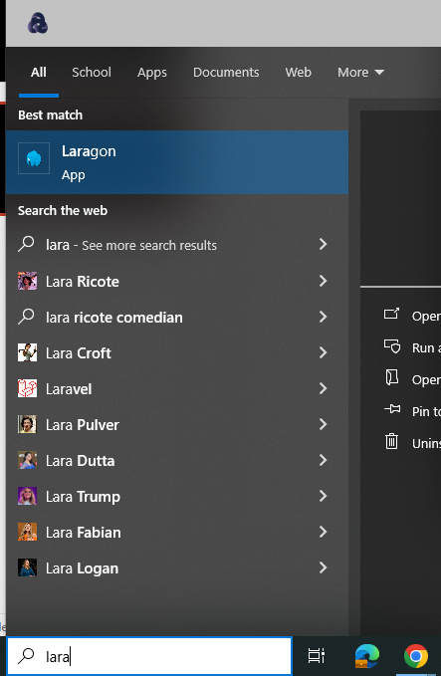
Laragon: Launching it
Open the start menu.
Then EITHER
Start typing Laragon and it should appear
Or
Look through menu options for it

Slide 4
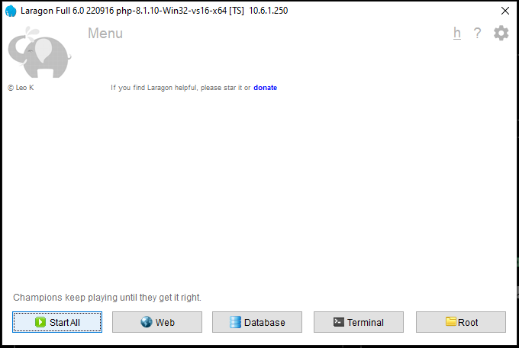
Laragon: Launch Webserver
Once it has opened
Click "Start All" to start the database and the Apache PHP interpreter

Slide 5
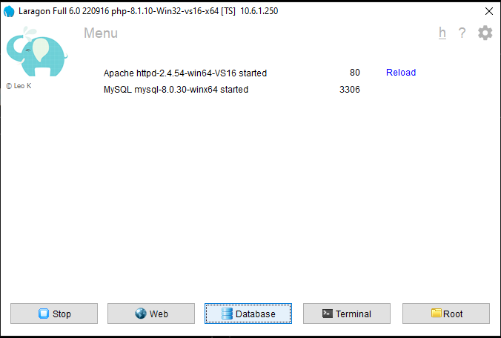
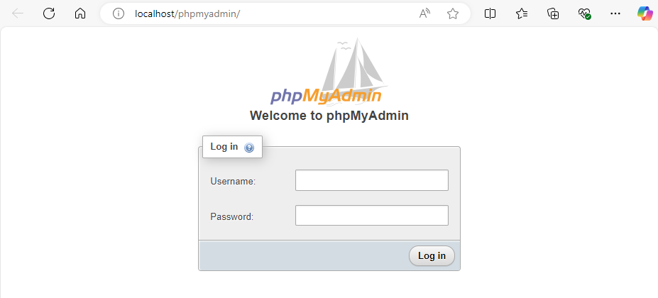
LARAGON: PHPADMIN
Once the services are running, click the "Database" button to launch PHPMYADMIN

Slide 6
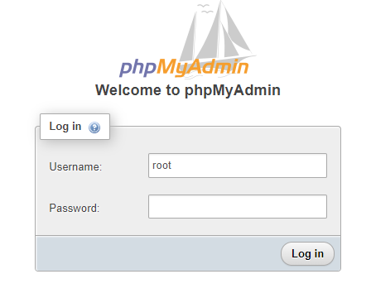
PHPMYADMIN: login
At this point, just enter "root" and no password to login as the ADMIN user.

Slide 7
ROOT user caution
A root user has complete and total control over all databases and users in the database system.
You should never use the root user to do anything other than create users and their databases... or drop them.
Any websites you build should have a user created and a database, just for that user / usecase. SEE OTHER GUIDE

